Slide 1
Unsupervised Learning Capstone
Classifying Mall Customers
Matthew Kehoe, January 2023

Slide 2
General challenges facing today’s malls
Foot traffic is down. Visits to indoor malls, open-air lifestyle centers, and outlet malls declined 7.4% in 2023.
Shopping habits are changing. Total retail sales will rise only 3.3% in 2023, while ecommerce sales will increase 10.0%.
There’s a lot of empty real estate. As revenues decline, retailers are unable to keep up with rent and operating costs and are closing hundreds of stores.
Source: Insider Intelligence, Market Research [1]

Slide 3
Classifying customers through Kaggle dataset
Kaggle dataset: data from 2,000 customers from loyalty cards at checkout (anonymized to protect privacy).
Data contains four continuous variables including annual income, age, customer id, and spending score.
Data has five categorical variables for city size, gender, marital status, level of education, and occupation.
Dataset: Customer Clustering Data [2]

Slide 4
The Kaggle dataset
Spending score is a number from 0-100 which predicts spending potential. Higher spending score translates to high spending potential.
Annual income ranges from $35,832 to $309,364 (US dollars).
Age range is from 18 years old to 76 years old.
Occupation includes unskilled workers, skilled workers, and managers.
Level of education is from high school to graduate school.

Slide 5
Unsupervised Machine Learning Problem
Can we classify the customers into groups based on the information available?
Three Continuous Variables:
Annual Income
Age
Spending Score
Unsupervised ML Problem: What is the optimal number of clusters? What do customers in these clusters have in common?

Slide 6
Exploring and Cleaning the dataset

Slide 7
Data Exploration: size of dataset
The shape of the dataset is (2000,9). So, there are 2,000 records and 9 columns.
Three of the nine columns are continuous variables representing income, age, and spending score. I can use these for clustering.
Five of the nine columns are categorical variables. I will use these for exploratory data analysis and visualization.
The final column is customer id. I won’t analyze this feature.

Slide 8
Data Cleaning: removing or replacing data
The dataset has already been cleaned, so I don’t need to perform any further analysis.
All nine columns have relevant data. I don’t need to replace null values.

Slide 9
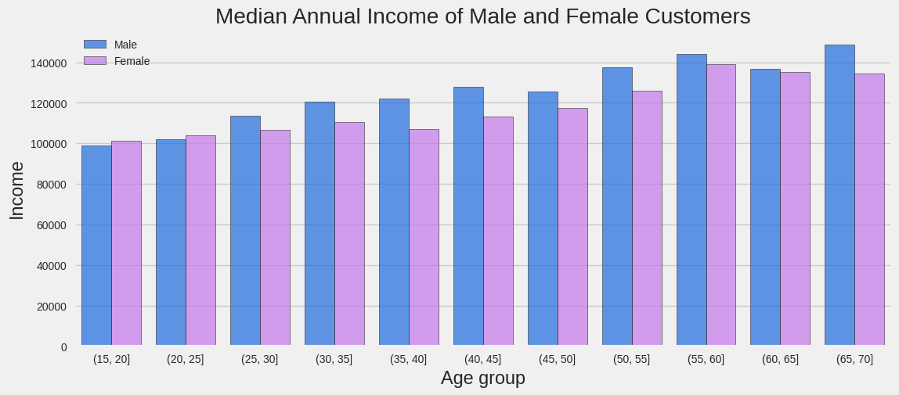
Data Exploration: annual income by gender and age

Slide 10
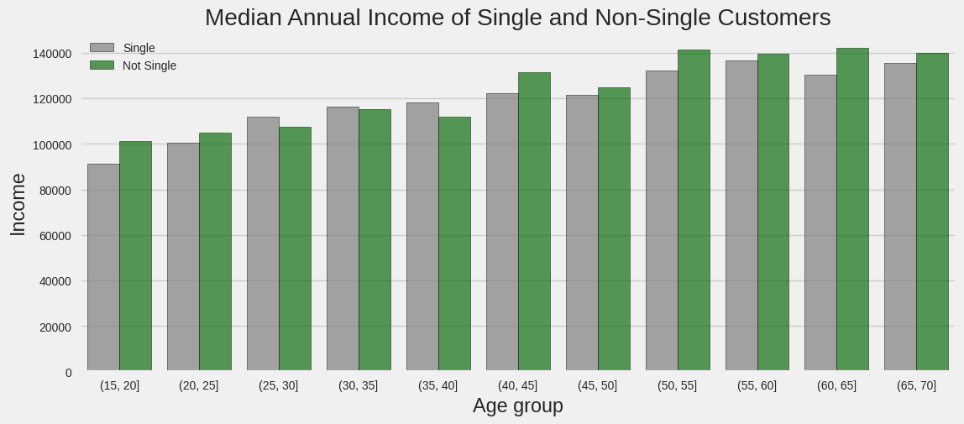
Data Exploration: annual income by marital status and age

Slide 11
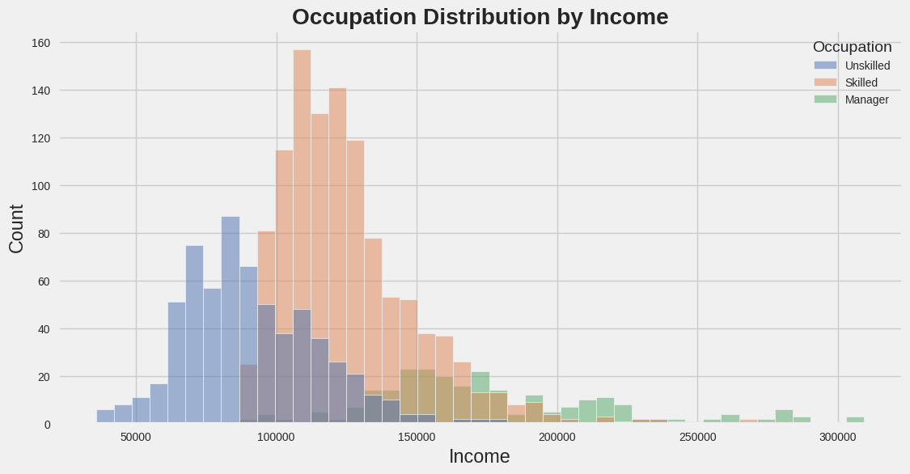
Data Exploration: annual income by occupation

Slide 12
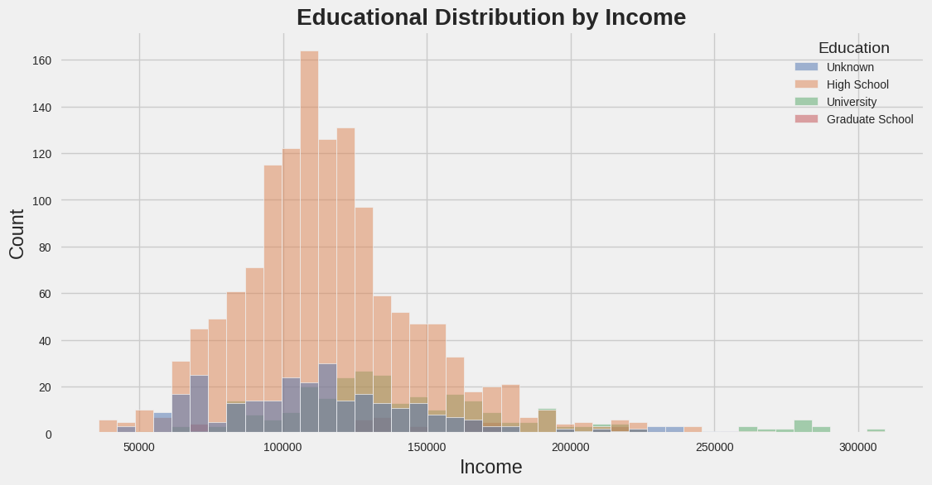
Data Exploration: annual income by education

Slide 13
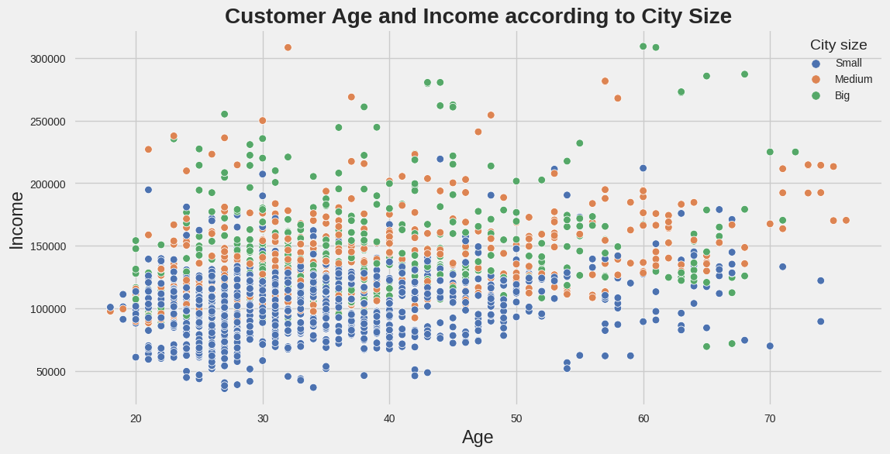
Data Exploration: age and income by city size

Slide 14
Model preparation

Slide 15
Model Preparation: Correlation between columns
My dataset has the shape of (2000,9) with 9 features.
I now want to investigate if any of the features are highly correlated.
To do this, I will use a heatmap to visualize correlations between features.

Slide 16
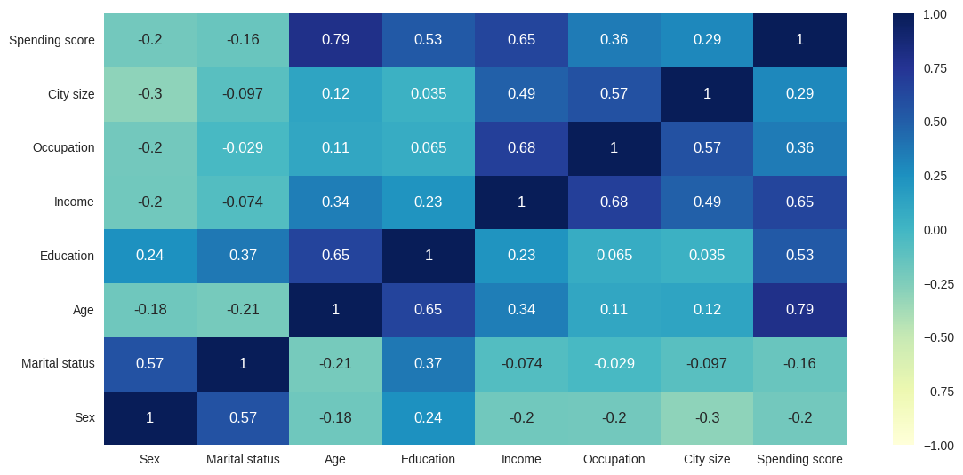
Model Preparation: Heatmap

Slide 17
Model Preparation: features for clustering
The heatmap shows that age, education, income, occupation, and city size are correlated with spending score.
To setup my unsupervised ML problem I will keep the continuous variables.
Feature Variables for Clustering:
Annual Income
Age
Spending Score

Slide 18
Model Preparation: using heuristics
Before I begin using unsupervised ML techniques, I need to establish heuristics from prior data analysis.
It seems sensible that a high annual income would increase spending score and that highly educated individuals would have a high income.
At the very least, my model should separate consumers into two groups:
Group 1: Low income, skill, and education. Low spending score.
Group 2: High income, skill, and education. High spending score.

Slide 19
Model Results, Clustering, and Dimensionality Reduction

Slide 20
Clustering
Three continuous features sounds like a great case for clustering customers into groups.
The K-Means algorithm is my first choice as it is one of the simplest and popular unsupervised ML algorithms.
As a second choice , I will also try a density-based clustering algorithm such as DBSCAN.
The Gaussian Mixture Model (GMM) is my third option.
I will also use Agglomerative clustering and PCA for dimensionality reduction and visualization.

Slide 21
Model Performance
Best performers, ranked:
K-Means
Gaussian Mixture Model
DBSCAN
Both K-Means and Gaussian Mixture Model accurately split customers into four groups. DBSCAN looks for clusters based on point density and did not generalize well to clusters which are less dense.

Slide 22
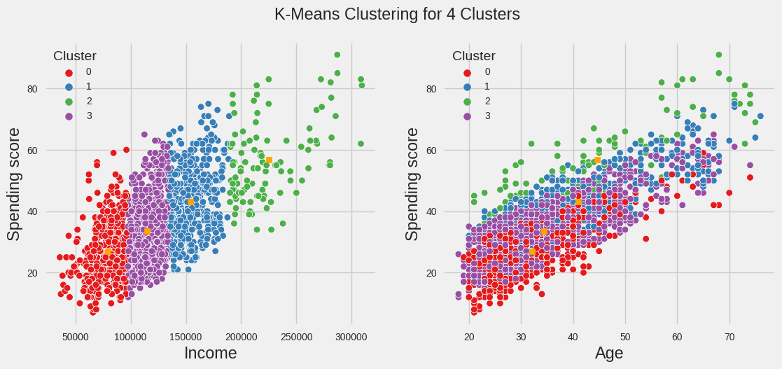
Model Results: K-Means Clustering

Slide 23
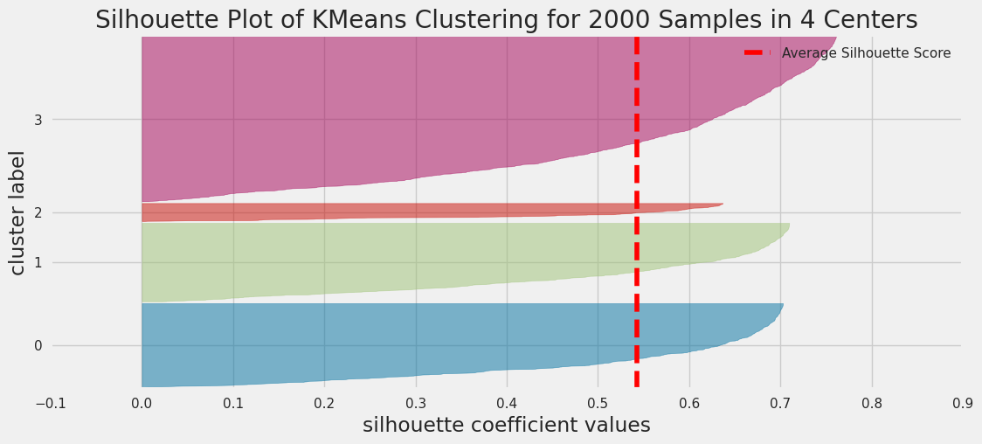
Model Results: Silhouette Score of K-Means Clusters

Slide 24
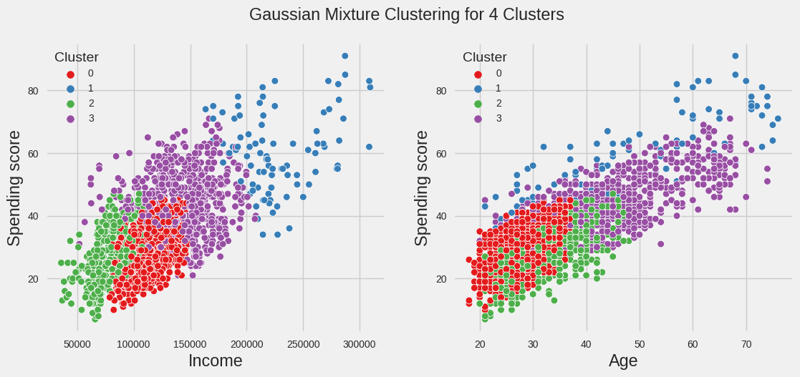
Model Results: Gaussian Mixture Clustering

Slide 25
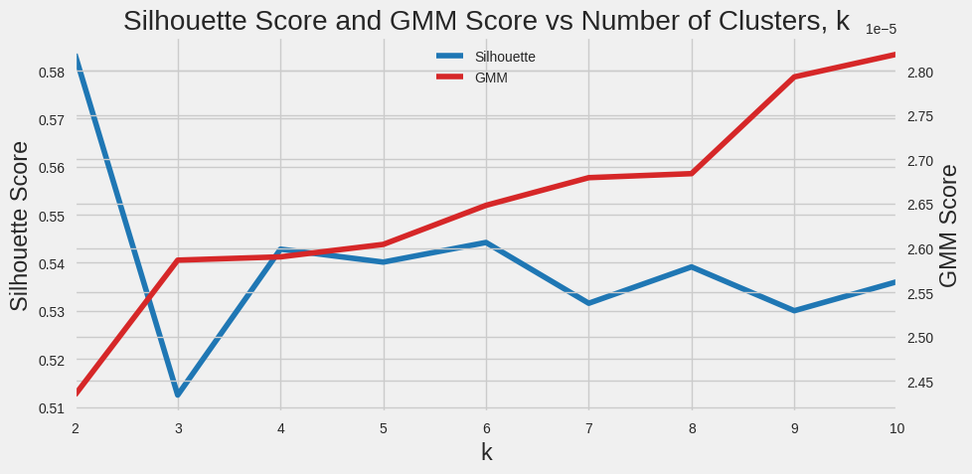
Model Results: Silhouette Score of Gaussian Mixture

Slide 26
Model Results: verified my heuristic
Both K-Means and GMM gave favorable results with four clusters.
Customers with low annual income generally have a low spending score.
Customers with a higher annual income have a higher spending score.
Older customers have a higher spending score.

Slide 27
Conclusions and Future Work

Slide 28
Conclusions
Based on consumer data from 2,000 individuals, I categorized customers by age, annual income, and spending. I also had access to several categorical features such as education, gender, and occupation.
Skilled and highly educated individuals earn more than those who are less skilled. A person living in a big city generally has a higher annual income than one in a small city.
Through data visualization, I found that males made more money than females and singles made more money than those that were not single.
Spending scores were higher among older and higher-earning individuals. Therefore, malls should target older and more educated consumers who are more likely to spend money.

Slide 29
Real World Applications
The findings of this investigation could be shared with the mall's marketing team. The cluster analysis would also be valuable for store managers looking to open new locations.
Other clustering techniques could be used to group customers. A 2022 study [3] used Mini Batch K-means and Mean Shift.
Customer clustering techniques can be used to identify new customers as described in this 2017 thesis [4].
A comprehensive analysis of clustering algorithms and real-world applications is described in this Neptune AI blog post [5].

Slide 30
Additional Features for Classifying Customers
A 2021 study [6] analyzed factors influencing customer segregation at shopping malls. Further analysis can be performed by adding:
Location of the customers (Rural, Urban)
Life stage of the customer (Married, Working, Jobless, Etc.)
How many children the customer has
Monthly disposable income of customers
Ethnic demographic of customers

Slide 31
Recommendations for further research
The five categorical variables: city size, education, gender, marital status, and occupation could be analyzed further to determine their impact on customer groups.
Outside of looking at age, income, and spending score, I could analyze other factors which influence customer spending in shopping malls. According to a 2017 study [7], mall architecture, security, music, and available parking all have significant impact on consumers.
I could also segment customers based on their activities in the mall. According to a 2004 study [8], mall atmosphere (odors, music and decorations), density (number of shoppers), and store preferences also have a large impact on consumer spending.

Slide 32
Notebook Locations
A Jupyter notebook of my work can be found here.

Slide 33
Questions/Discussion

Slide 34
References
Feger, A. 3 challenges facing today’s malls—and how retailers can overcome them. Insider Intelligence, 19 April 2023, https://www.insiderintelligence.com /content/3-challenges-facing-today-s-malls-and-how-retailers-overcome-them. Accessed 02 Jan. 2024. [1]
Sharma, D. Customer Cluestring Model for Data Science. Kaggle, 02 Jan. 2021. https://www.kaggle.com/datasets/dev0914sharma/customer-clustering. Accessed 02 Jan. 2024. [2]
Narayana, V. Lakshman, et al. "Mall customer segmentation using machine learning." 2022 International Conference on Electronics and Renewable Systems (ICEARS). IEEE, 2022. [3]
Norlin, Patrik, and Viktor Paulsrud. "Identifying New Customers Using Machine Learning: A case study on B2B-sales in the Swedish IT-consulting sector." (2017). [4]

Slide 35
References (Continued)
Aravind CR. Exploring Clustering Algorithms: Explanation and Use Cases. Neptune AI (MLOps Blog), 9 Aug. 2023. https://neptune.ai/blog/clustering-algorithms. Accessed 02 Jan. 2024. [5]
Arul, V., Ashutosh Kumar, and Aman Agarwal. "Segmenting Mall Customers Data to Improve Business into Higher Target using K-Means Clustering." 2021 3rd International Conference on Advances in Computing, Communication Control and Networking (ICAC3N). IEEE, 2021. [6]
Kushwaha, Tarun, Satnam Ubeja, and Anindita S. Chatterjee. "Factors influencing selection of shopping malls: an exploratory study of consumer perception." Vision 21.3 (2017): 274-283. [7]
Ruiz, Jean-Paul, Jean-Charles Chebat, and Pierre Hansen. "Another trip to the mall: a segmentation study of customers based on their activities." Journal of Retailing and Consumer Services 11.6 (2004): 333-350. [8]

